Slide 1
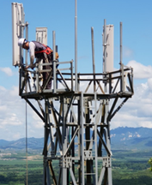
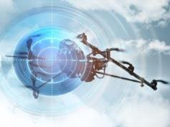
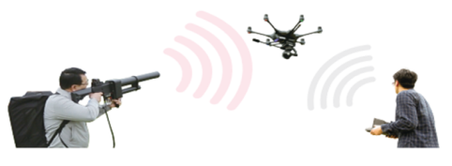
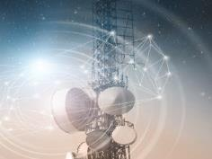
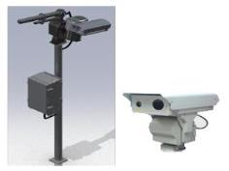


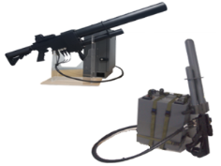

  Samjung Solution Co., Ltd.
  & Anti-drone Solutions
  December. 8, 2025

Slide 2
Contents
System Operation Concept Diagram
Manufacturing Facility Status
Key customers

Slide 3

  Drone Terrorism, is it real?
Implications
TB-2
Photography
Killing
Weapons
Means of
Terrorism/War
Notes:
As we have seen in these two cases,
There are many changes in the implications of drones.
At the time of the development of drones,
most people had concerned about illegal filming.
As widely reported in the international media,
Beyond being used as a attacking weapon for human life,
It is evolving to the point as the main means of war or terrorism, nowadays.
이러한 두 가지 사례에서 살펴본 바와 같이
드론이 내포하고 있는 의미가 많은 변화가 있습니다.
드론을 개발할 당시에는 그저 단순한 불법 촬영행위 등이 문제가 되었던 반면에
해외언론에 많이 보도된 바와 같이
이제는 인명에 대한 살상무기로 이용되는 수준을 넘어서서
전쟁이나 테러의 주요 수단으로 까지 진화하고 있습니다.

Slide 4
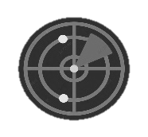
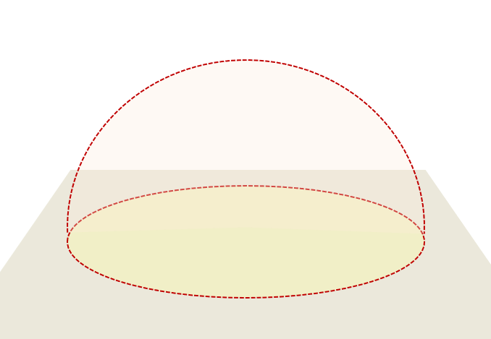
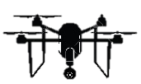
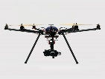

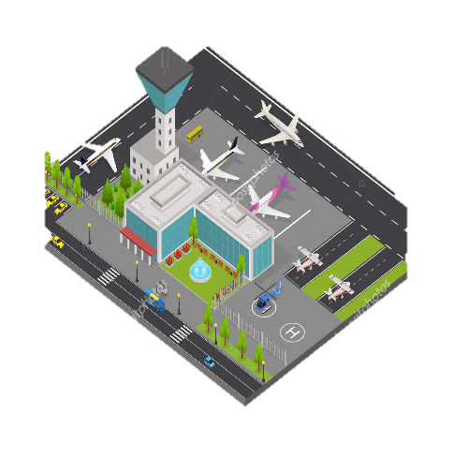
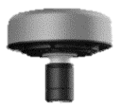

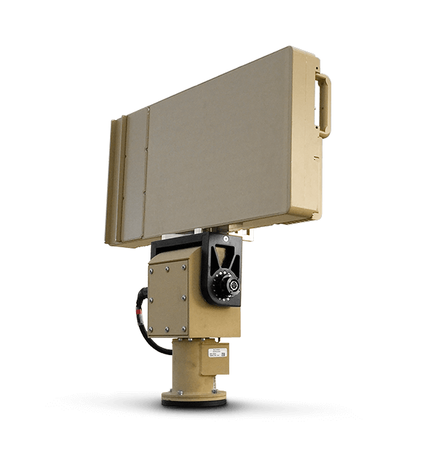


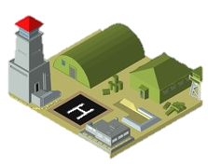
Anti-Drone Technology
  Anti-drone system is the technology to neutralize illegal drones being used as a means of attack and terrorism
Detect · Identify
Capturing drone flights and tracking routes around facilities that need to be protected
Neutralize
Dropping illegal drones through communication and GPS interference, etc.
RADAR, RF Scanner, EO/IR
Jamming, Spoofing, Laser
• Analyze drone signals,
detect directions, track locations
Use RF Scanners to detect drones, track their location
Anti-Drone System
• Neutralize Drone
Neutralize drone by using Jammer
• Detect Drone
Detect Drone access by using precision Radar
• Identify Drone
Identify between bird and drone by using O/IR Camera
RF Scanner
Jammer
Radar
EO/IR
  National Major Facilities
Notes:
Before we get into main presentation, let me briefly talk about the anti-drone system.
As you know very well,
Anti-drone system is that neutralizes drones
that can be used illegally as a means of attack and terrorism.
The technology to implement this is
detection and identification to capture and track the flying routes of illegal drones.
It involves the entire process of neutralization also.
It is dropping them by interfering with communication
between the drone operator and the drone, and GPS signals, etc.
Radars are typically used for detecting the approach of drone.
RF scanners analyze drone signals to detect orientation, track their location.
EO/IR cameras distinguish between birds and drones.
Finally, the drones can be neutralized by jamming equipment.
본 내용에 들어가기 전에 여러분 모두 잘 아시는 내용이겠지만
먼저 안티드론 시스템에 대해서 간단하게 말씀드리겠습니다
안티드론 시스템은 불법으로 공격 및 테러수단으로 이용될 수 있는 드론을 무력화하는 시스템입니다.
이를 구현하는 기술은
국가중요시설 주변 불법 드론의 비행을 포착하고 경로를 추적하는 탐지 및 식별과
드론 조종자와 드론 간의 통신과 GPS 신호를 방해하는 방법 등을 사용하여
불법드론을 떨어뜨리는 무력화의 전 과정이 포함됩니다.
일반적으로 레이더를 이용하여 드론의 접근을 탐지하고
RF스캐너로 드론 신호를 분석하여 방향을 탐지하고 위치를 추적하며
EO/IR카메라는 드론과 새를 구별하고
마지막으로 재머를 이용하여 드론을 무력화 시킬 수 있습니다.

Slide 5
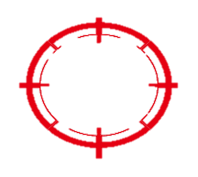
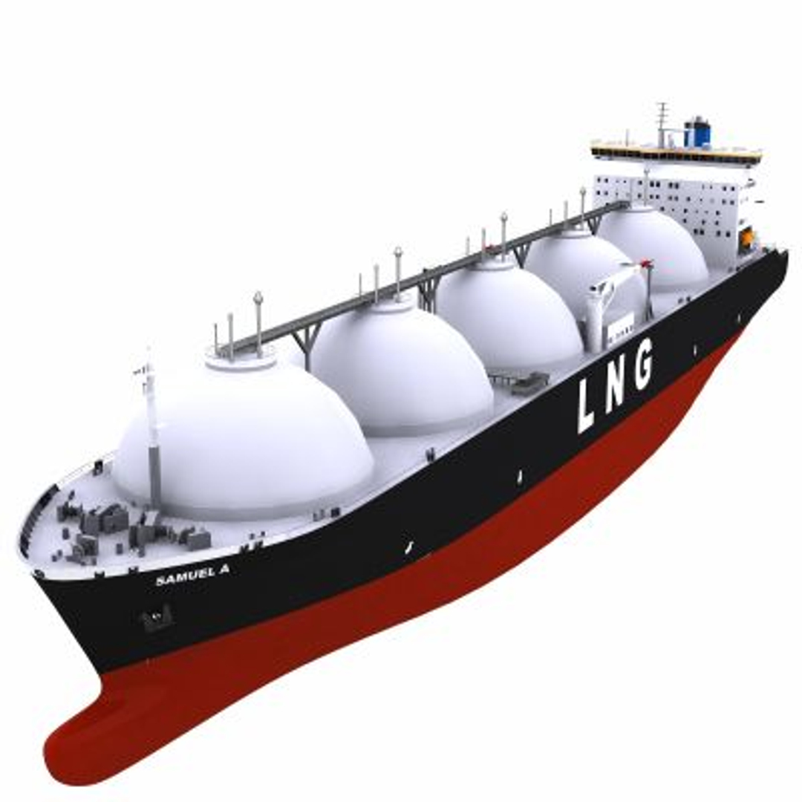
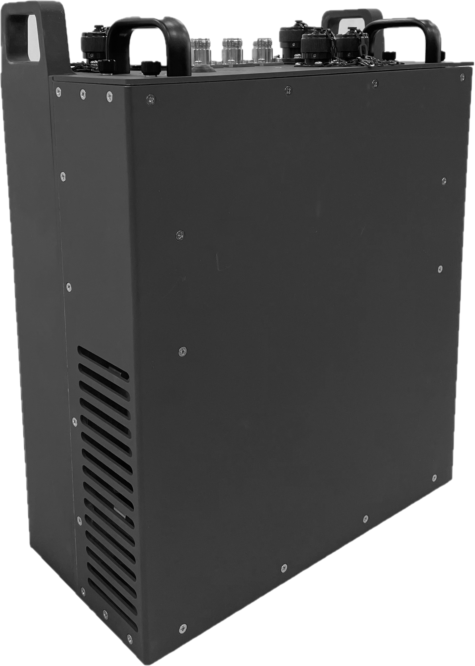
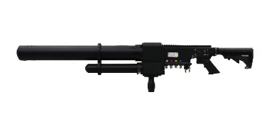
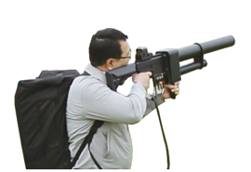
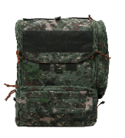
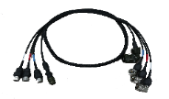
1. System Operation Concept Diagram
A. 4 Portable Anti-drone Guns on LNG Carrier
  Antenna
  Main Body
  Link Cable
7 / 7
  Carrying Bag

Slide 6
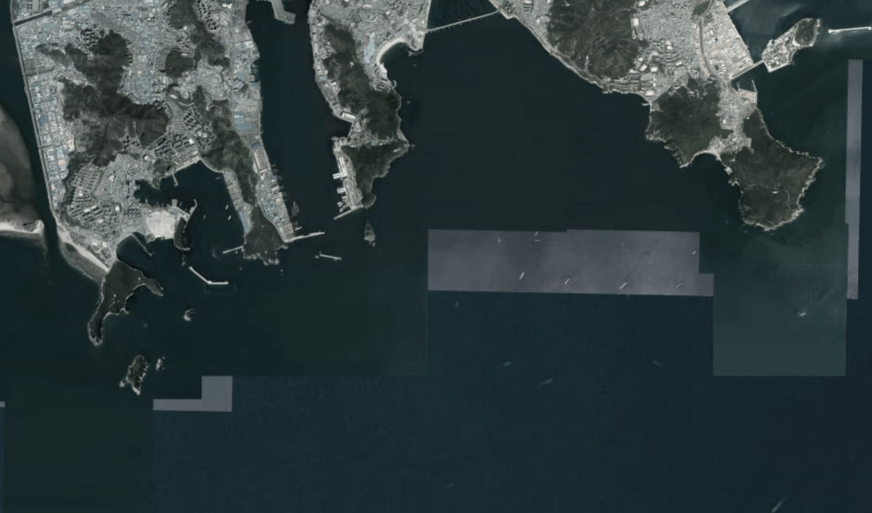

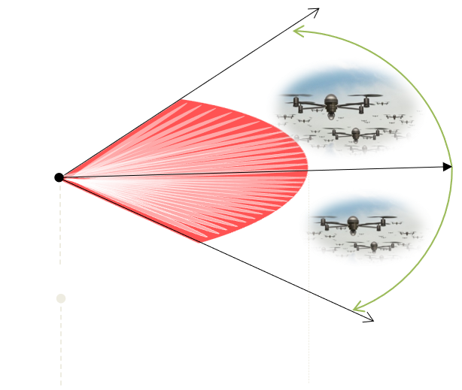





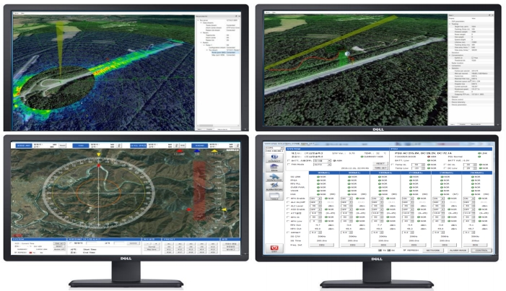

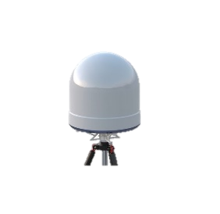




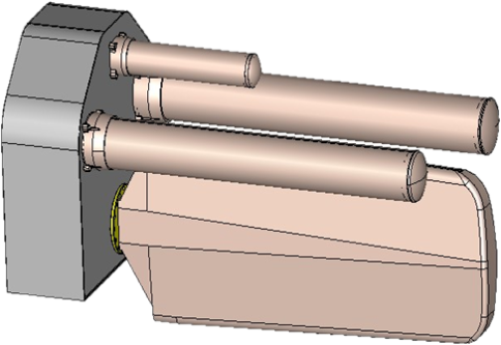

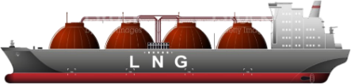
1. System Operation Concept Diagram
B. Long-range Anti-drone System on LNG Carrier
  Antenna
  Jammer
  Integrated Control System
  Detection 360° 5km
  EO/IR
  Radar
  Control Center
  Recognition 2km
  Identification 1km
  Neutralization 360° 2km
7 / 7
Notes:
This LNG carrier can also respond
by installing an integrated anti-drone system.

Slide 7
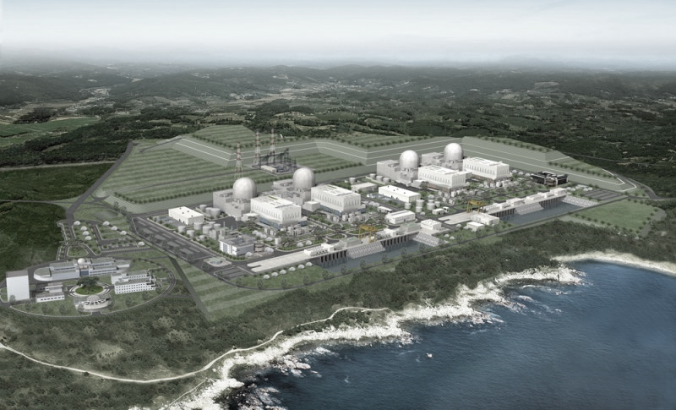





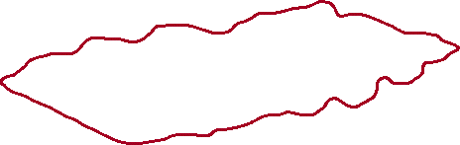

1. System Operation Concept Diagram
C. Long-range Anti-drone System on Critical Facilities
Perimeter
Radius : 2km
Critical Facilities
Jammer
  Antenna
  Jammer
  Integrated Control System
  EO/IR
  Radar
  Control Center
7 / 7

Slide 8
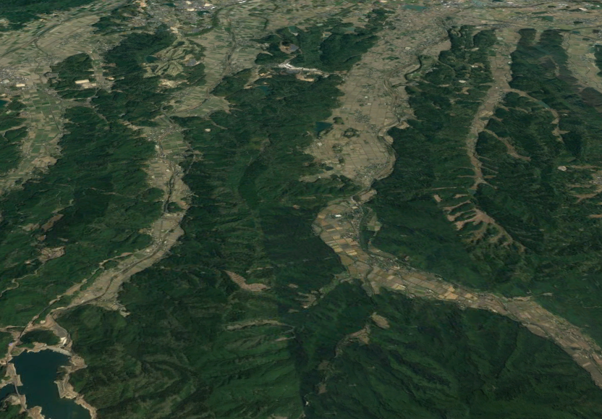

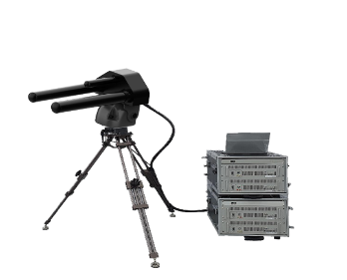
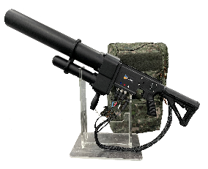
1. System Operation Concept Diagram
D. Anti-drone System on military demarcation line
GNSS 5km
GNSS 5km
ISM 2km
ISM 2km
military demarcation line
Long distance
Jammer
Long distance
Jammer
GP
GP
500m
Short distance
Jammer

Slide 9
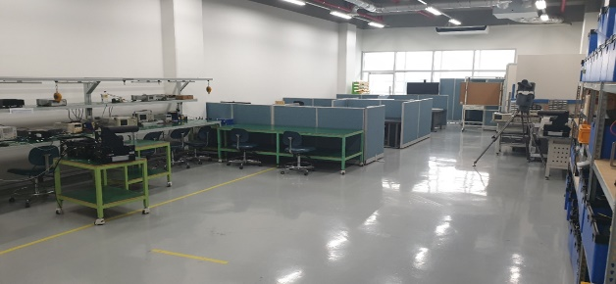
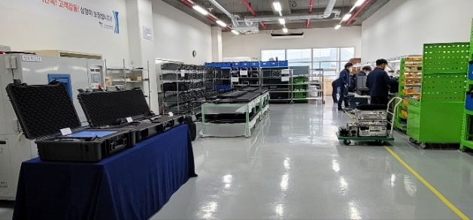
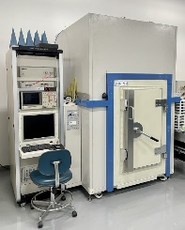
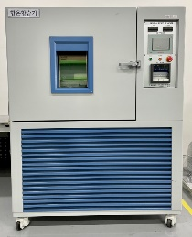
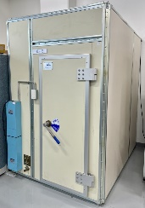
2. Manufacturing Facility Status
R&D Center(Room Size 131㎡)
Approvals/Permission
Class | Detail | Status
Approval | Samjung Solution Corporation Establishment(2011.12) Inno-Biz(No.R170601-00482) Venture business(No.20210729030071)
Certification | Promising Small and Medium-sized Enterprise by the Gyeonggi Provincial Government(No.2018-149) Family-Friendly company(No.2018-0421) R&D Center(No.2013112050) ISO 9001:2015(Q303716) ISO 14001:2015(E148316)
License | Information and communications construction business | No.311007
Registration | Factory (Wired communication equipment manufacturing and 19 others) Registration of manufactured goods by the Public Procurement Service (Jamming device and 5 others) Software Business (package software development and others)
Test and Qualification | Thermo-hygrostat and 16 others
business registration certificate | Software Business Entity(developing pakage software, etc.)
Manufacturing Facility(Room Size 136㎡)
Environmental Test Equipment
Antenna
Chamber
Thermo-Hygrostat
Shield Room

Slide 10





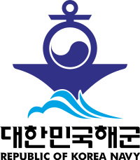



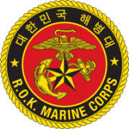




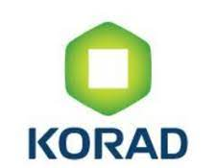



3. Key customers
  Samjung Solutions Co., Ltd. developed and delivered wide variety of products to important national facilities such as nuclear power plants and other public institutions and corporations as below.
Key Clients
4 / 7

Slide 11
  Thank you.
Venture For Tomorrow, SJ SOLUTION
Tel : +82(31)342-1120
+82(10)8009-4343
e-mail : yunkuchoi@sjsolution.com
Web : http://www.sjsolution.com

